Slide 1
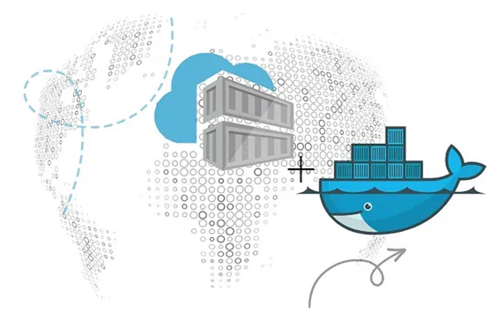
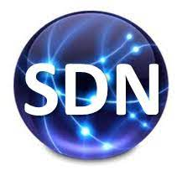
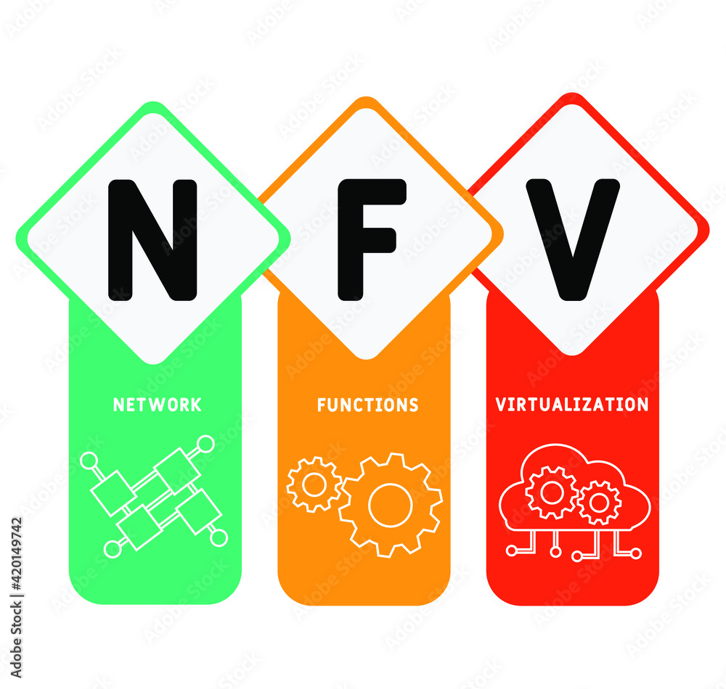
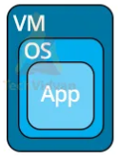
PDS
Computer Vision
Deploy Applications in Kubernetes using Open Tofu
.
https://github.com/siagianp
https://www.youtube.com/@AmelOline/videos
https://github.com/amelcharolinesgn2/IoT_simulator-mqtt-NodeRed
https://github.com/amelcharolinesgn2/Cloud-Infrastructures
Notes:
https://www.itwonderlab.com/kubernetes-with-opentofu/
https://www.itwonderlab.com/kubernetes-with-opentofu/

Slide 2
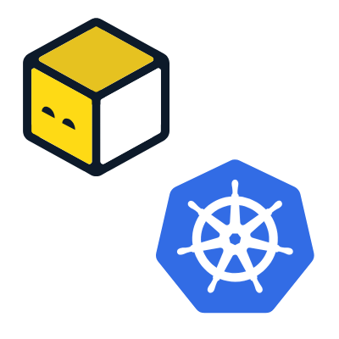
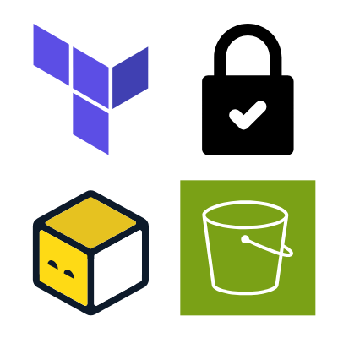
Publishing Containers in Kubernetes with OpenTofu
How to deploy applications in Kubernetes using OpenTofu
Install OpenTofu and a local Kubernetes cluster like K3s
Install OpenTofu and your favorite distribution of Kubernetes for local deployment, e.g. see K3s.io.
Check the Kubernetes Context
Use the command kubectl config view to check Kubernetes cluster connectivity and the context used.
Create an OpenTofu plan file
Create an OpenTofu plan file describing the desired Kubernetes resource deployment.
Initialize OpenTofu Plan
Initialize the OpenTofu plan to download the necessary provider plugins.
Execute OpenTofu Plan and Apply
Check and apply the changes that OpenTofu will perform on the Kubernetes cluster to deploy the application.
Check that the Application has been deployed
Check that Kubernetes has deployed the application.
Add a Load Balancer or a NodePort to access the Application
Add a Kubernetes Load Balancer or NodePort to access the application web server port from your local machine.
Access the Application with a web browser
Access the Application from a web browser.
Destroy the Kubernetes Application using OpenTofu
Use OpenTofu to remove the Kubernetes resources created by the application.
Notes:
https://kubernetes.io/docs/concepts/configuration/manage-resources-containers/
https://www.itwonderlab.com/kubernetes-with-opentofu/

Slide 3
Deploying Deep Learning Models on Kubernetes with GPU

Slide 4
Kubernetes For AI Hyperparameter Search Experiments |

Slide 5
Github
Automate provisioning in the self-service platform
Notes:
https://conferences.oreilly.com/artificial-intelligence/ai-ny-2019/public/schedule/detail/72321.html
https://s.itho.me/events/2019/k8s/1525-1605%20%E5%BC%B5%E5%AE%B6%E6%A3%A0_AI%20on%20Kubernetes.pdf
https://medium.com/hackernoon/gpus-kubernetes-for-deep-learning-part-1-3-d8eebe0dd6fe
https://github.com/alibaba/GPU-scheduler-for-deep-learning

